Slide 1
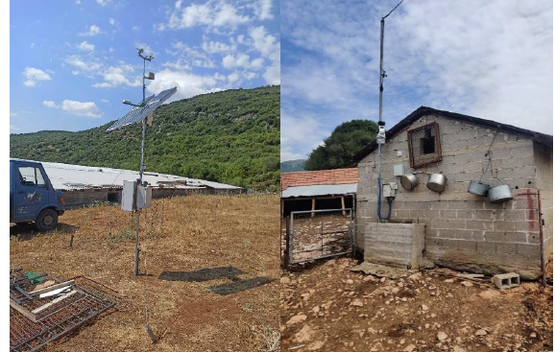
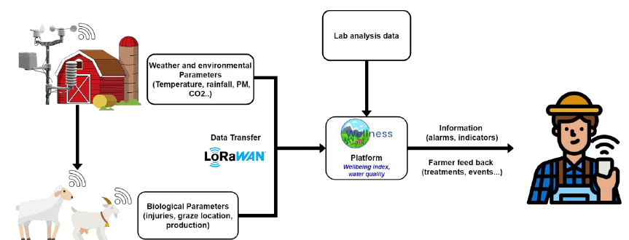
Welfare monitoring and management system for small ruminants in the wider area of Bourinos
The Problem
Technologies, such as the Internet of Things (IoT), have the potential to revolutionize livestock management in agriculture by improving product quality, sustainability, and production. Using IoT technologies in farming may help with evidence-based decision-making, encourage resource sustainability, and provide real-time data.
This integration lowers overall expenses by enabling the methodical monitoring and assessment of crucial data that may be used to gauge animal wellbeing. As so, it makes it possible to handle the whole milk production and processing cycle logically, from production to market.
The Project
The project concerns the development and pilot implementation of a system for recording production parameters and holistic management of sheep and goat farms belonging to the milk zone of two selected cheese factories with the aim of improving the quality characteristics of the milk produced and enhancing the added value of the products produced. The project will utilize new technologies for collecting and mining data in the entire milk production and processing cycle. The new knowledge will help producers and processors in the development and consolidation of a competitive, innovative value chain, strengthening local entrepreneurship, as well as their export and development prospects.
WELLNESS Overall Objective
The project utilizes IoT technologies, wireless sensor networks, smart devices and unmanned aerial vehicles for the monitoring and management of livestock. The data is recorded in a decision support information system, which through advanced algorithms will help identify and inform about potential problems and will proceed to prioritize and propose appropriate solutions.
The main objectives of the project are a) Strengthening the competitiveness and sustainability of local producers/enterprises by reducing the overall cost and improving the quality of primary milk production and dairy products through the implementation of new technologies - precision livestock systems for monitoring and managing livestock and an information system for decision-making support, b) Strengthening entrepreneurship in the Region of West Macedonia and increasing employment by adding value to the produced dairy products, through increasing the production and marketing of quality livestock products of particular local importance, c) Transferring the results produced at the level of the milk zone for holistic management, providing new development, export and market opportunities. The proposed project is expected to provide a comparative advantage by implementing solutions of scientific excellence.
Figure 1. Meteorological stations in pilot farms.
Figure 2. WELLNESS project main concept.
The Approach
Development and pilot implementation of a modern precision livestock farming system based on IoT technologies, sensors and smart devices for the assessment of the welfare of sheep and goats by systematically recording critical parameters of the milk production process on selected farms. This will be followed by the development of a livestock management information system with an emphasis on milk quality and hygiene, which will be supported by a decision support system. The ultimate goal is to transfer the results to the dairy zone level with the aim of increasing the added value of the products produced and strengthening competitiveness. The first step is the development and pilot implementation of an IoT system for real-time collection of animal physical parameters and assessment of welfare. Recording, analysis and prioritization of the most important factors causing low productivity and evaluation of milk composition will follow. Furthermore, the creation of a model livestock management system will follow.
Characterization for cumulative co-exposure
Expected Impacts
The aim of the project is to modernize livestock management, in order to improve primary milk production and processing and ultimately strengthen the competitiveness of local producers/enterprises by increasing the added value of the products. The primary sector has the potential, through increasing the production, standardization and marketing of quality livestock products, with identity and locality, to increase its participation in the regional GDP and contribute to increasing employment. The continuous monitoring and evaluation of animal performance and breeding conditions by the information system can contribute to increasing the quantity and optimizing the composition of the milk produced, ensuring the production of competitive products with specific quality characteristics. In addition, early diagnosis and treatment of pathological conditions can prevent their spread, contributing to reducing production costs.
The Project Partners
Contact:
Dr. Georgios Banias
Senior Researcher
g.banias@certh.gr | +30 2311 257650

